Slide 1
Predict Survival From Titanic Dataset With Tensorflow
1. Hansen Idden - hansenidden@gmail.com - hansenidden
2. Ariefan Dipokusumo Wibowo - ariefandw@gmail.com - ariefandw
3. Tesya Nurintan - tesyant@gmail.com - tesyant

Slide 2
Metadata of the dataset
Variable | Definition | Key
survival | Survival | 0 = No, 1 = Yes
pclass | Ticket class | 1 = 1st, 2 = 2nd, 3 = 3rd
sex | Sex
Age | Age in years
sibsp | # of siblings / spouses aboard the Titanic
parch | # of parents / children aboard the Titanic
ticket | Ticket number
fare | Passenger fare
cabin | Cabin number
embarked | Port of Embarkation | C = Cherbourg, Q = Queenstown, S = Southampton

Slide 3
Framing & hypothesis
The main goal is use machine learning techniques to create a model that predicts which passengers survived the Titanic shipwreck,
In this problem, we tried to build a predictive model that answers the question: “what sorts of people were more likely to survive?” using passenger data (ie name, age, gender, socio-economic class, etc).

Slide 4
Preparation needed
Separating data training and data testing into 2 separate files
Fill the missing value with mean strategy
def nan_imputer(data, columns):
for column in columns:
imputer = SimpleImputer(missing_values=np.nan, strategy='mean')
data[column]=imputer.fit_transform(data[column].values.reshape(-1,1))
return data
Dropping non concerned column to be our features
def drop_not_concerned(data, columns):
return data.drop(columns, axis=1)
not_concerned_columns = ["PassengerId","Name", "Ticket", "Fare", "Cabin", "Embarked"]
train_data = drop_not_concerned(train_data, not_concerned_columns)
test_data = drop_not_concerned(test_data, not_concerned_columns)

Slide 5
Techniques
We build our model using neural network.
We used Xavier weights initialization technique that tries to make the variance of the outputs of a layer to be equal to the variance of its inputs.
We used Rectified Linear Unit (ReLU) for activation function in our model
And used Adam optimization algorithm to update network weights iterative based in training data.

Slide 6
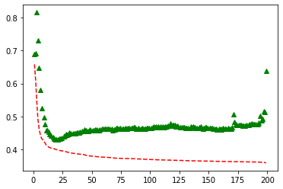
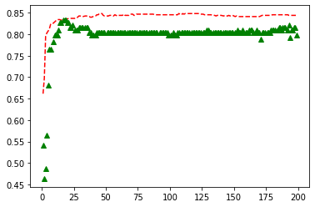
Results and conclusions
We train the data for 200 epoch and get this results:
And get the validation Accuracy about 80%
Train loss and valid loss
Train accuracy and valid accuracy

